Slide 1

How do regularization techniques and output noise influence the trajectory and stability of interaction recovery in MLPs, as measured against ground truth?
MAASTRICHT UNIVERSITY · SCHOOL OF BUSINESS AND ECONOMICS
Edouard Dewaerheijd
Supervised by Selim Eren · June 2026
BACHELOR OF SCIENCE IN BUSINESS ANALYTICS · THESIS DEFENSE

Slide 2
THE PROBLEM
Neural networks are powerful but opaque. NID reads interactions from learned weights but those weights depend on how you trained the model.
RESEARCH QUESTION
How do regularization techniques and output noise influence the trajectory and stability of interaction recovery in MLPs, as measured against ground truth?

Slide 3



BACKGROUND
What the literature already knows
TSANG ET AL. · 2017
LENGERICH ET AL. · 2021
ARPIT ET AL. · 2017
NID reads weights
Dropout cuts interactions
Signal before noise
change the weights, change the readout.
decays higher-order paths exponentially.
models learn structure in early epochs.
What’s missing : how regularisation and noise jointly shape the weights NID reads, measured as a trajectory against ground truth.

Slide 4
BACKGROUND
What NID does, and why it depends on training
inputs
hidden
NID reads interaction strength from weight magnitudes, so any training decision that changes those weights also changes what NID detects.
x1
x2
output
x3
THREE GAPS THIS STUDY FILLS
x4
Weight-level effects : do training choices change the very weights NID reads, or only generalisation?
Trajectories, not endpoints : do recovery patterns across epochs reveal what a final checkpoint misses?
Joint regularisation + noise : how do these two factors interact when both are present?
shared hidden units route the interaction

Slide 5
METHODOLOGY
Experimental design
OUTPUT NOISE η 5 levels
0, 0.1, 0.2, 0.5, 1.0
800
OPTIMIZER 2 levels
Adam, SGD
MODEL RUNS
DROPOUT 2 levels
off, 0.2
WEIGHT DECAY λ 2 levels
off, 10⁻⁴
10 synthetic functions with known ground truth. so detected interactions can be checked against the true ones.
ARCHITECTURE 2 models
small [64, 64] · big [140, 100, 60, 20]
5 noise × 2 optimizers × 2 dropout × 2 weight decay × 10 functions × 2 architectures = 800 runs

Slide 6
METHODOLOGY · METRIC
How we measure recovery
WHAT IT MEASURES
1.0
Does NID rank true interactions above false ones? AUPRC rewards finding all true interactions before accumulating false positives.
Precision
AUPRC
THE NUMBERS
AUPRC = ∫ P(r) dr
random baseline
~4
1,013
0
TRUE INTERACTIONS
CANDIDATES
0
1.0
Recall
random baseline ≈ 0.004

Slide 7
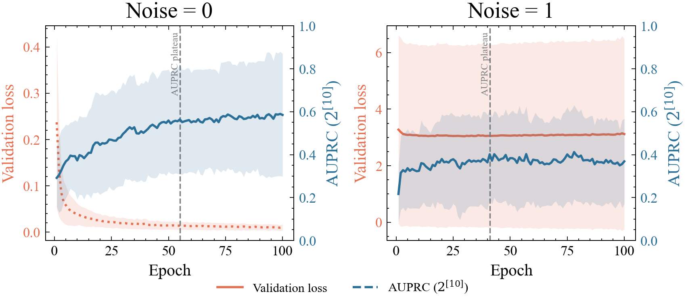
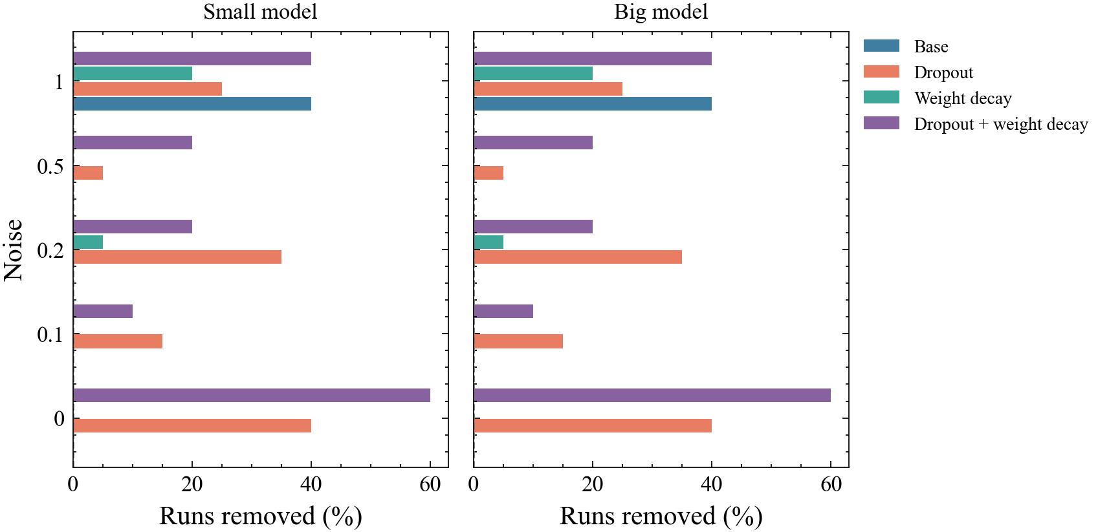
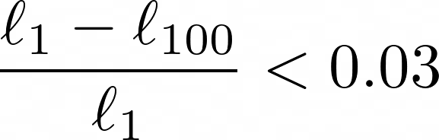
METHODOLOGY
WHY THE CONVERGENCE FILTER
Measuring recovery
WHY AUPRC
1,013
~4
candidates
true positives
CONVERGENCE FILTER

Slide 8
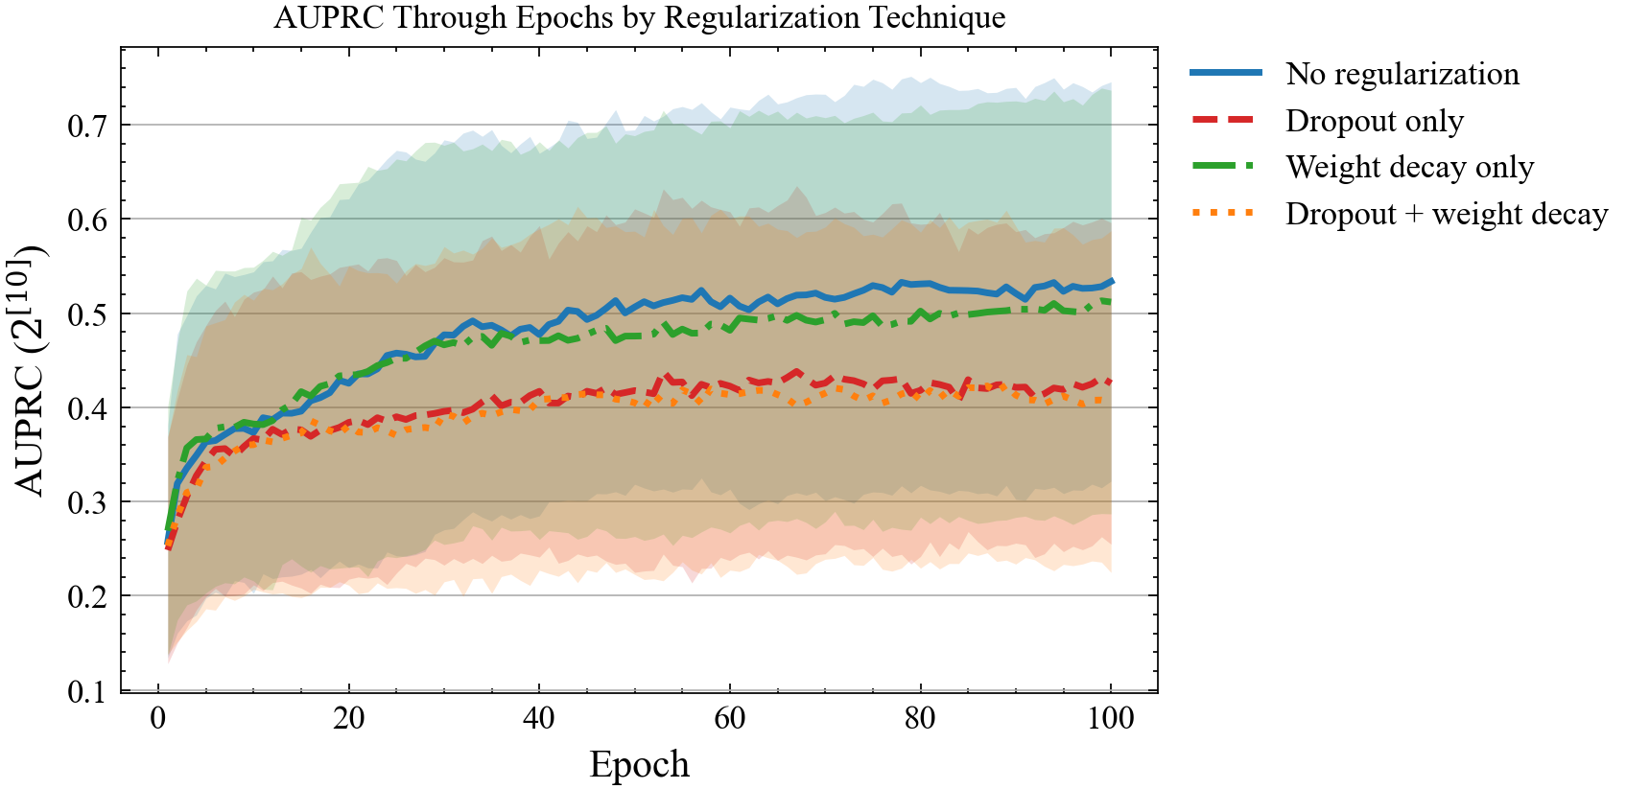
RESULTS · REGULARIZATION
Dropout suppresses interaction recovery
BASE
reference
0.524
WEIGHT DECAY
−7.1%
0.486
DROPOUT
−22.9%
0.404
DROPOUT + WEIGHT DECAY
−23.7%
0.400
The mechanism designed to prevent overfitting actively suppresses the weight structure that NID needs.
Dropout + weight decay ≈ dropout alone, dropout is the dominant factor.

Slide 9
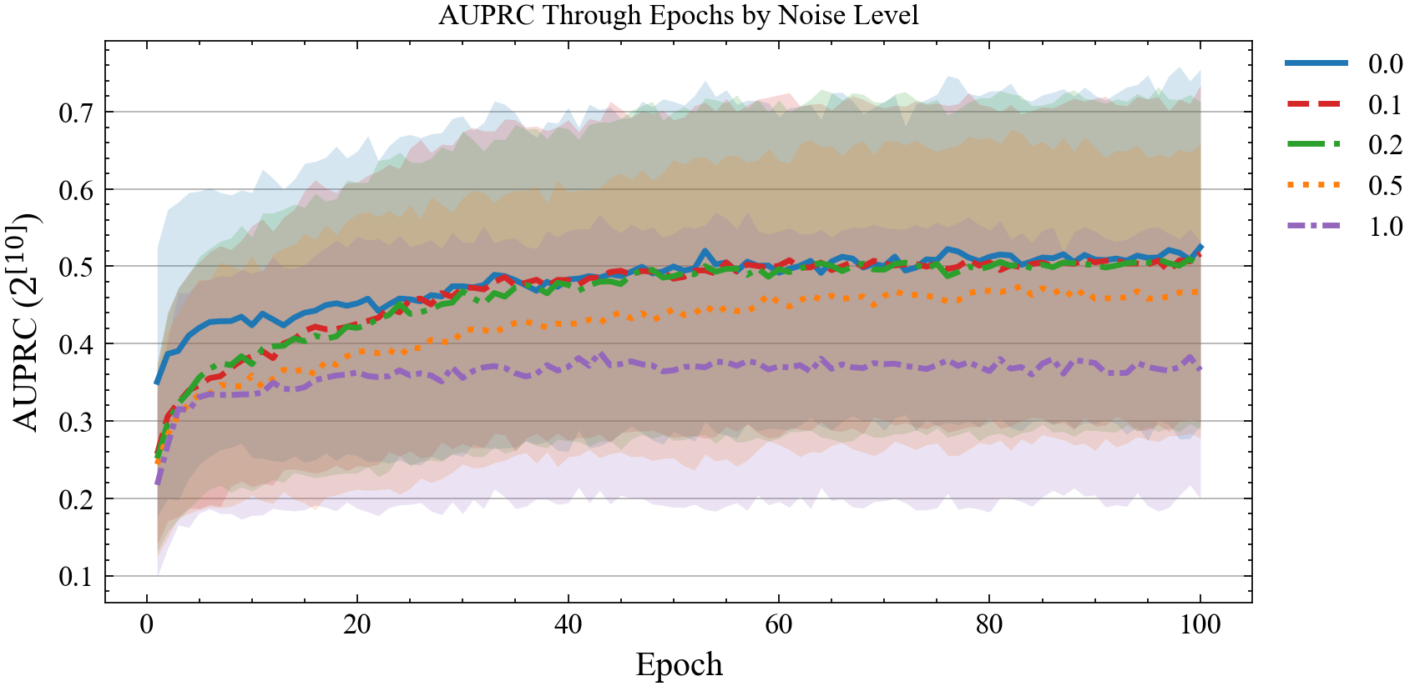
RESULTS · NOISE
Noise lowers the ceiling, not the shape
NOISE η = 0
0.564
reference
NOISE η = 1
0.360
−36%
SAME SHAPE, DIFFERENT CEILING
All five noise levels show the same early rise and plateau by epoch ~20 only the height changes.
Interaction structure is encoded in the first 20 epochs, before noise fitting competes.

Slide 10
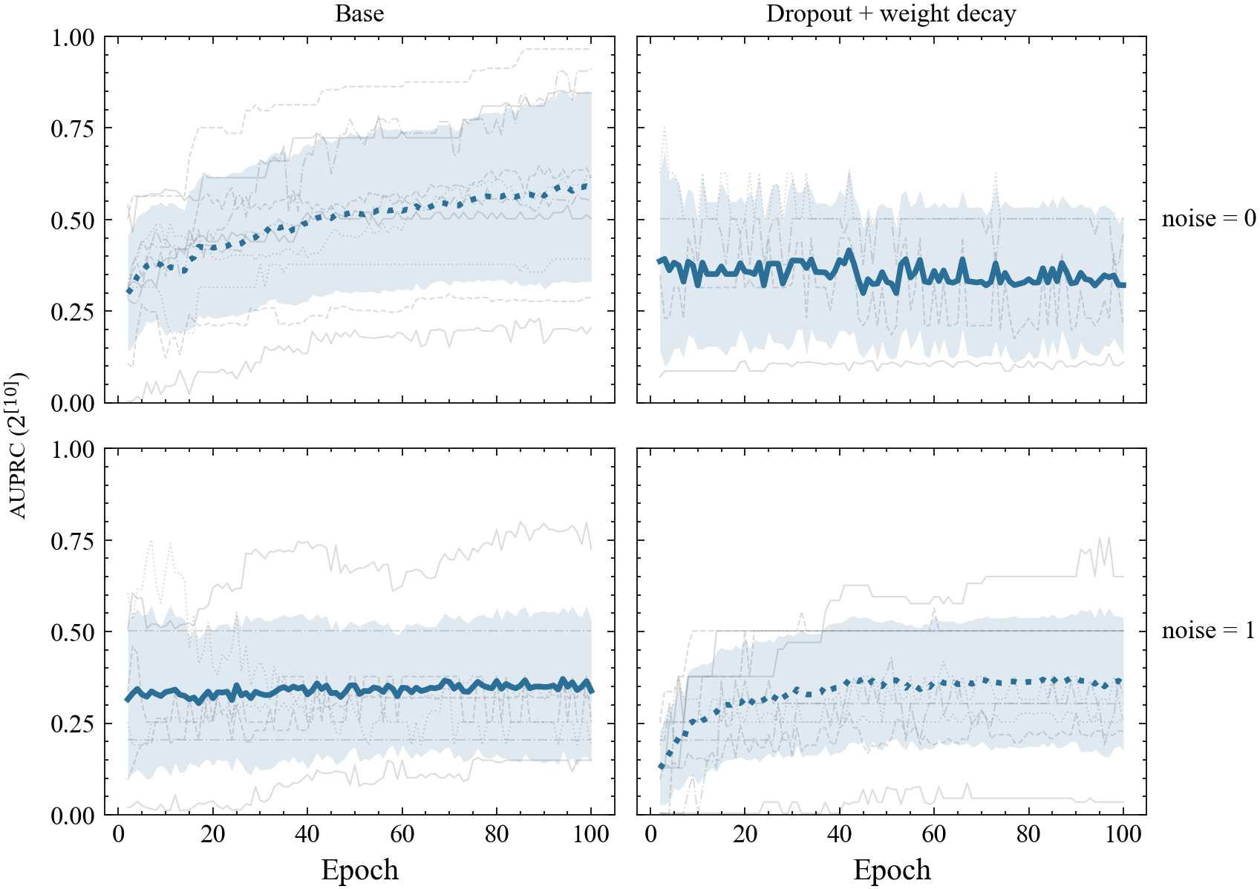
RESULTS · STABILITY
Trajectory reveals what endpoints miss
TOP · LEFT
TOP · RIGHT
Progressive recovery
base condition keeps improving through epoch 100
Flat from epoch 5
dropout destroys recovery immediately, not gradually
BOTTOM · LEFT
BOTTOM · RIGHT
Early ceiling, stable
noise sets the floor — trajectory shape unchanged
Brief rise, then suppressed
regularization briefly delays noise fitting but can’t sustain it
Evaluating only at best validation loss misses all of this — the trajectory is the finding.

Slide 11
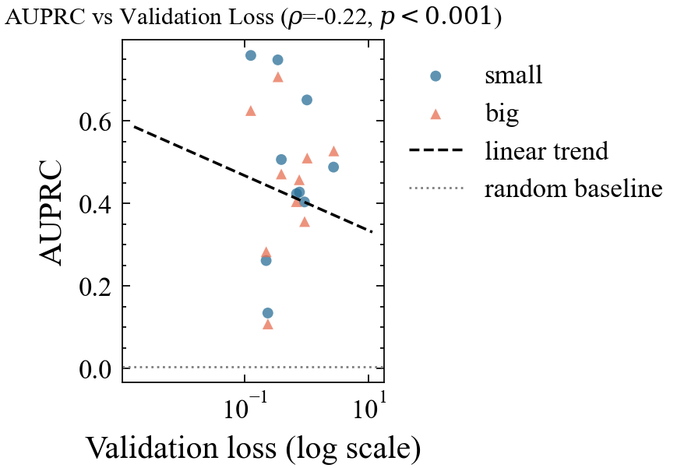
RESULTS · MODEL SELECTION
Validation loss ≠ interaction recovery
Ρ = −0.22
Spearman correlation · n = 626 · p < 0.001
WHAT THIS MEANS
→
Validation loss explains only a small fraction of variance in AUPRC.
→
Models at the same val loss can differ by 0.4 AUPRC points, nearly the full observable range.
→
Ground-truth evaluation is necessary, not optional for picking the best model for interaction detection.

Slide 12
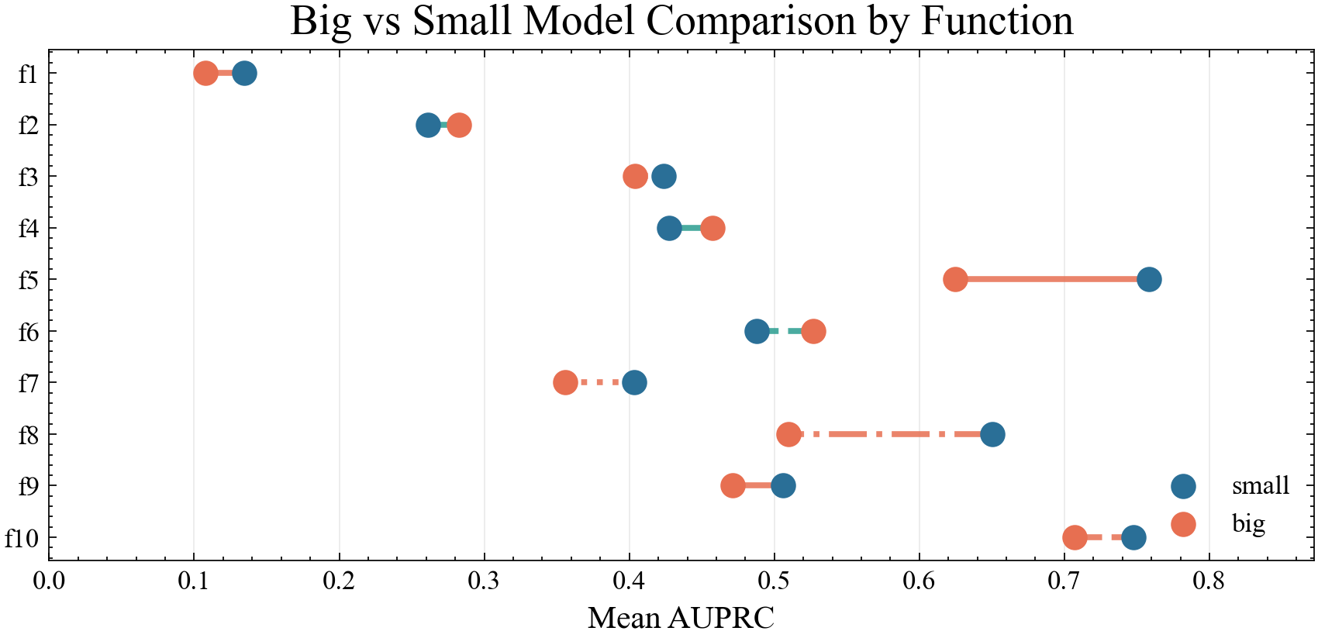
RESULTS · ARCHITECTURE
Smaller models recover interactions more reliably
7
of 10
benchmark functions where the small model wins
THE INTUITION FAILS
You’d expect more capacity to recover more complex interaction structure.
But the big model loses most on functions where recovery is otherwise highest.
More capacity = more opportunity to fit noise and spurious patterns, not better interaction recovery.

Slide 13
DISCUSSION · MECHANISM
Why these results make sense
DROPOUT
WEIGHT DECAY
before
after λ
→
input
hidden
output
ordering preserved
Changes which pathways exist
Only shrinks magnitudes
Disabling hidden units destroys the shared routes that NID requires to detect interactions.
Lengerich et al. (2021) — dropout as order-specific regulariser
L₂ pulls every weight toward zero proportionally, so the relative strength ordering NID reads stays intact.
Goodfellow et al. (2016) — L₂ shrinkage is magnitude-only

Slide 14
DISCUSSION · LIMITATIONS
What this study can and can’t tell us
01
SINGLE-SEED RUNS
02
SYNTHETIC DATA ONLY
Stability claims are limited: within-condition variance can’t be separated from function-level differences.
Transfer to real-world datasets with messy, correlated features is unknown.
03
NID AS FIXED INSTRUMENT
04
OUTPUT NOISE ONLY
Results describe what NID reads, other detectors (SHAP, H-statistic) may behave differently.
Input-feature noise has different dynamics and is not covered here.
FUTURE WORK
→ Multi-seed replication
→ Real-world datasets
→ NID vs SHAP interactions

Slide 15
CONCLUSION
Four answers to one question
How do regularization techniques and output noise influence the trajectory and stability of interaction recovery in MLPs, as measured against ground truth?
01
Dropout suppresses interaction recovery by 22.9% weight decay does not. The dominant factor is which pathways exist, not their magnitude.
REGULARISATION
02
Noise lowers the recovery ceiling without changing the early trajectory shape interaction structure is encoded in the first 20 epochs.
OUTPUT NOISE
03
Validation loss is a weak proxy for interaction recovery (ρ = −0.22). Ground-truth evaluation is necessary, not optional.
MODEL SELECTION
04
Interaction structure is encoded in the first 20 epochs. Evaluating only at best validation loss misses the full story. The trajectory is the finding.
TRAJECTORY

Slide 16
Q & A
Questions?
RESEARCH QUESTION
How do regularization techniques and output noise influence the trajectory and stability of interaction recovery in MLPs, as measured against ground truth?
FOR REFERENCE
0.524
0.404
0.564 → 0.360
Ρ = −0.22
BASE
DROPOUT
η = 0 → η = 1
VAL LOSS ↔ AUPRC
no regularization
−22.9% vs base
noise lowers the ceiling
weak coupling, n = 626

